Slide 1

Career Quest: Navigating Challenges and Seizing Opportunities
By Anusha Kovi
Notes:
Don’t spend more than 3 seconds presenting this slide.

Slide 2


Customer Journey Map
Stage 1 - Before
Stage 2 - During
Stage 3 - During
Stage 4 -After
Awareness
Consideration
Decision
Action
Stages
Recognizing the need for a career change. Exploring personal interests and skills. Identifying potential new career paths.
Researching different industries and professions. Seeking advice from mentors.
Narrowing down choices based on personal preferences, potential for growth, and alignment with values.
Taking concrete steps toward the chosen career path or gaining hands-on experience through internships.
Steps
Taken
😄
😩
Informational Interviews
Networking Events
Career Development Programs
Mentor Guidance
Channels and Resources Used
😎
😄
😩
Excitement about the possibility of a new and fulfilling career.
Overwhelmed by the vast array of choices and the uncertainty of the future.
Anxious about making the right decision.
Confidence and motivation in taking actionable steps toward the chosen career.
Emotional
Journey
😎
😰
“I want a more satisfying career”
“I need guidance on what options are available to me.”
“I'm worried about making the wrong choice.”
“I am committed to making this change and building the necessary skills.”
Voice of Customer
😰
Notes:
57% - Junior, 10% - Sophomore, 30% - Senior; All are Currently residing in US but 77% are international, 20% are not international

Slide 3

Customer Profile
Job Opportunities
GAINS
Skill Recognition
Gaining Access to Mentorship
Lack of Experience
Career Clarity
Financial Stability
Limited Networking
Uncertain Career Paths
Competition
Difficulty Standing Out
Difficulty for Entry-Level Candidates
CUSTOMER JOBS TO BE DONE
Exploring Options
Financial Concerns
PAINS
Challenges in Expanding Professional Connections
Worries about the Cost of Education

Slide 4
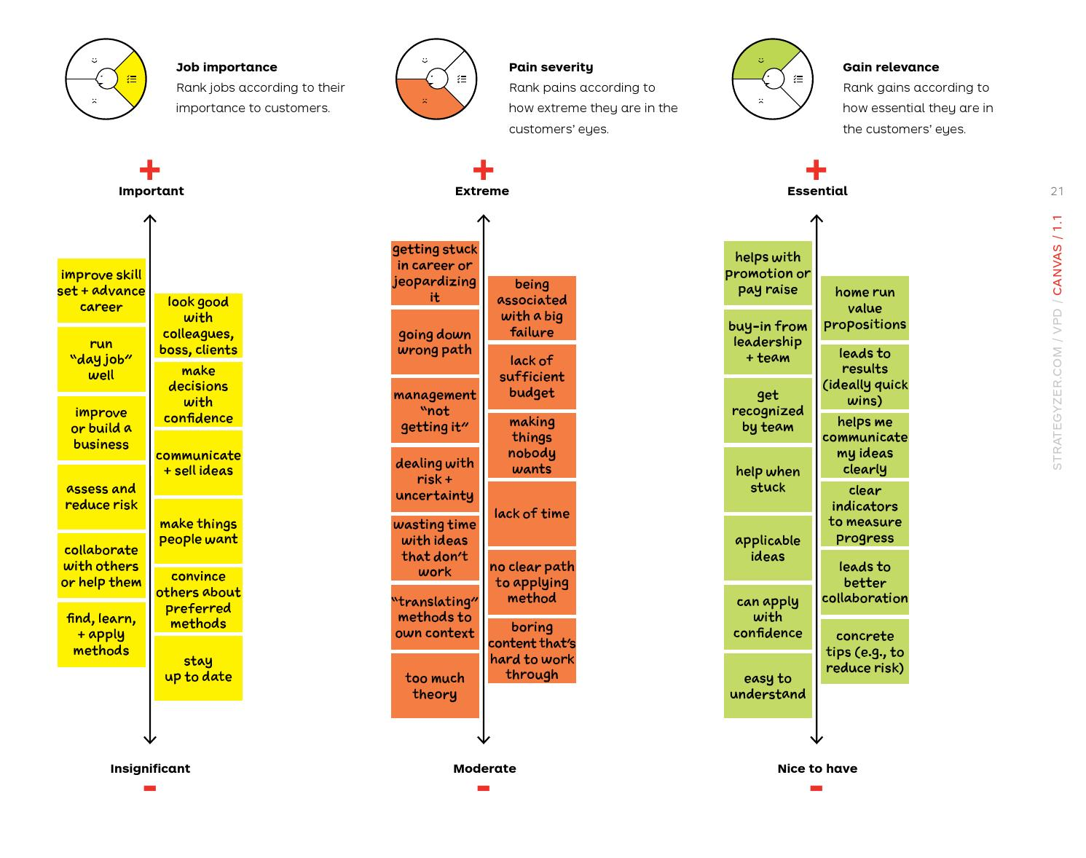
IMPORTANT
EXTREME
ESSENTIAL
Competition
Difficulty Standing Out
Job Opportunities
Lack of Experience
Difficulty for entry-level candidates
Skill Recognition
Limited Networking
Challenges in expanding professional connections
Professional Connections
Uncertain Career Paths
Exploring Options
Career Clarity
Financial Concerns
Financial Stability
Worries about the cost of education
INSIGNIFICANT
MODERATE
NICE TO HAVE
Notes:
JTBD, Pains, Gains are ranked based on my prompts given to chatgpt, explain those prompts

Slide 5
Customer Profile
 | JUNIOR STUDENTS
PRIORITY PROBLEM (What is the major problem / Job the customer is trying to solve?) | More than 50% of the Junior Students say that they are facing difficulty in standing out
ALTERNATIVES (How is the customer currently solving the problem) | LinkedIn for Networking, Online Courses, Teal for resume making/tracking applications, Events/Programs/Workshops/Seminars in University, YouTube for Interview Prep
$ SPENT (how many) (How much is the customer current spending to solve the problem?) | 71% students say they are willing to spend 20-40$ as a one-time investment for online courses/programs

Slide 6
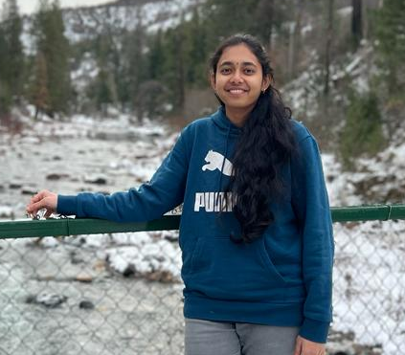



THANK YOU!
Connect with me on LinkedIn
akovi@mtu.edu
Michigan Technological University
Notes:
Don’t spend more than 15 seconds presenting this slide.
Recap the insights from the data analysis setting the premise for what could be the next steps to improve the website.

